Slide 1
Parallelism
Two types of parallelism:
Spatial parallelism
duplicate hardware performs multiple tasks at once
Temporal parallelism
task is broken into multiple stages
also called pipelining
for example, an assembly line

Slide 2
Parallelism Definitions
Token: Group of inputs processed to produce group of outputs
Latency: Time for one token to pass from start to end
Throughput: Number of tokens produced per unit time
Parallelism increases throughput

Slide 3
Parallelism Example
Ben Bitdiddle bakes cookies to celebrate traffic light controller installation
5 minutes to roll cookies
15 minutes to bake
What is the latency and throughput without parallelism?

Slide 4
Parallelism Example
Ben Bitdiddle bakes cookies to celebrate traffic light controller installation
5 minutes to roll cookies
15 minutes to bake
What is the latency and throughput without parallelism?
Latency = 5 + 15 = 20 minutes = 1/3 hour
Throughput = 1 tray/ 1/3 hour = 3 trays/hour

Slide 5
Parallelism Example
What is the latency and throughput if Ben uses parallelism?
Spatial parallelism: Ben asks Allysa P. Hacker to help, using her own oven
Temporal parallelism:
two stages: rolling and baking
He uses two trays
While first batch is baking, he rolls the second batch, etc.

Slide 6
Spatial Parallelism
Latency = ?
Throughput = ?

Slide 7
Spatial Parallelism
Latency = 5 + 15 = 20 minutes = 1/3 hour
Throughput = 2 trays/ 1/3 hour = 6 trays/hour

Slide 8
Temporal Parallelism
Latency = ?
Throughput = ?

Slide 9
Temporal Parallelism
Latency = 5 + (10) +15 = 30 minutes = 1/2 hour
Throughput = 1 trays/ 1/4 hour = 4 trays/hour
Using both techniques, the throughput would be 8 trays/hour

Slide 10
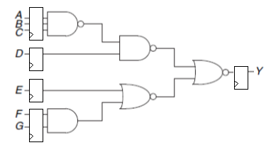
Temporal Parallelism
Compute max frequency, knowing that t_{pcq}=15ps t_{gate_pd}=40ps and t_{su}=65ps
Compute Latency
Compute Throughput

Slide 11
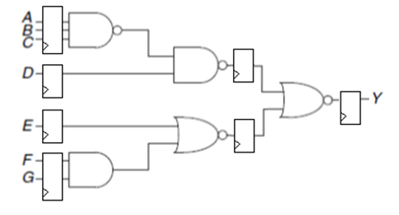
Temporal Parallelism
Compute max frequency, knowing that t_{pcq}=15ps t_{gate_pd}=40ps and t_{su}=65ps
Compute Latency
Compute Throughput

Slide 12
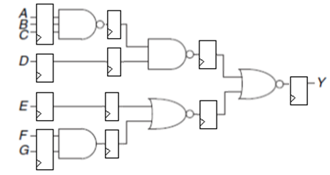
Temporal Parallelism
Compute max frequency, knowing that t_{pcq}=15ps t_{gate_pd}=40ps and t_{su}=65ps
Compute Latency
Compute Throughput

Slide 13
Esercizio FSM

Slide 14
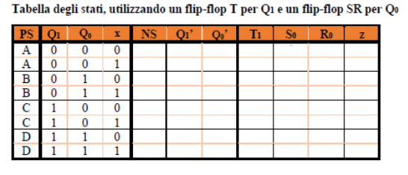
Esercizio FSM

Slide 15
Esercizio FSM

Slide 16
Esercizio FSM

Slide 17
Verilog FSMs
1. Progettare una FSM con 2 input (up/down) ed un output a 8 bit (contatore).
Contatore incrementa di 1 ogni volta che premo UP e decrementa di 1 ogni volta che premo DOWN.
Scrivere un testbench che controlla il funzionamento della FSM

Slide 18
Verilog FSM (1/2)
Progettare una FSM con 2 input (up/down) ed un output a 8 bit (contatore).
Contatore incrementa di 1 ogni volta che premo UP e decrementa di 1 ogni volta che premo DOWN.
Scrivere un testbench che controlla il funzionamento della FSM e simularlo sul simulatore Basys3

Slide 19
Verilog FSM (2/2)
Progettare una FSM con 2 input (up/down) ed due output a 4 bit (decine ed unita).
I due output decine ed unità sono 2 cifre di un numero in codifica BCD. Il numero viene incrementato di 1 ogni volta che premo UP e decrementato di 1 ogni volta che premo DOWN.
Scrivere un testbench che controlla il funzionamento della FSM e simularlo sul simulatore Basys3

